Slide 1
UR-CAVM
YEAR 4 HORTICULTURE
MODULE: AGRICULTURE EXTENSION
L.U: TECHNOLOGY TRANSFER SKILLS AND STRATEGIES
TITLE: In Rwanda, farmer field school (FFS) is a farmer-based extension approach that provides proximity extension services to farmers in the country. Detail the FFS structure, activities, achievements and ways of improvement in Rwanda
GROUP 6
LECTURER: Dr HABIMANA Sylvestere

Slide 2
GROUP 6 MEMBERS
NAMES | REG NO
ALLELUIA Amen | 217074359
MANIZABAYO Theoneste | 217062679
NIYOKUBAHWA Espoir | 217117643
NTIGURIRWA Thierry | 217025013
TUYISHIMIRE Irene | 217148263
MUGABE Joshua | 217007694
NIYONSABA Clementine | 217019463

Slide 3
INTRODUCTION
Farmer field school (FFS) is an informal education approach to adult farmers where the field is the classroom and farmers study through learning by doing, experimentation, observation and reflection (Khisa & O’Brien, 2014).
This approach was established in 1989 by FAO (Food and Agriculture Organization of the United Nations) in south Asia as a way for small scale rice farmers to experiment and to adopt integrated Pest Management (IPM) through learning by doing. This approach spread quickly in other continents including Africa due to its effectiveness in helping to control rice pests (Khisa & O’Brien, 2014).

Slide 4
Under the support of Belgian development agency through IPM project, Rwandan government introduced FFS approach in 2009 in order to boost farmer’s skills, self-innovative ability and decision making capacity in their own field (Ruganzu et al, 2015).
FFS also know as Classroom without walls improved farmers confidence in analysis and decision making because they learn from what they are experiencing in the field work. For sure even though this approach is recently adopted in our country, it had improved the farm productivity to those who adopted it.

Slide 5
OBJECTIVE
After this reading this document you will know:
What is Farmer Field Schools.
What is FFS Structure
Activities done in FFS
Achievements of FFS in Rwanda
And ways of improvements of FFS in Rwanda

Slide 6
LITERATURE REVIEW
what is Farmer Field School (FFS)?
FFS approach is an interactive learning approach which focuses on discovery based learning, experimentation and observation, group reflection of the results and making informed decision based on the results (hagiwara, 2011, Mesoamerican, n.d).
FFS is a seasonal long experiment where farmers learn from field since land preparation up to harvesting stage of the crop under study. The FFS group meet on weekly or biweekly basis emphasizing on biological, agronomical and management issues where farmers carry out agroecosystem analyses, problem identification and making design, conducting and interpreting field experiments using practice of farmers to improve practice comparisons(Khisa & O’Brien, 2014).

Slide 7
FFS is a group made of 25-30 farmers with one trained facilitator to facilitate them not to teach them (Ruganzu et al, 2015). The group regularly meet on weekly basis over a period of time to learn ‘how and why’ of a situation in a given context under study (Khisa & O’Brien, 2014).
Why Farmer Field Schools (FFS)?
FFS approach, is a participatory approach where local farmers get involved in analysis of their livelihood systems, identify their main constrains and test possible solutions that are suitable to their local condition (Khisa & O’Brien, 2014).

Slide 8
The purpose of FFS is to build decision making capacity of participants where farmers become able to analyze their production systems, recognizing problems, examine possible solutions and boost the farmers to adopt the practices that are favorable to their farming systems (Hagiwara et al, 2011).

Slide 9
FFS STRUCTURE
FFS structure is made of two important parts. The first is the training of FFS Facilitators and the second group is the training of farmers.
FFS facilitators are arranged in training of trainers (TOT) groups where they are trained by qualified FFS Master trainers from either Governments agency or non- Government organization(NGO) (CICA/MINAGRI, RAB & BTC,2017).
FFS facilitators are trained in a TOT learning plot on a weekly or biweekly basis per month through-out a season long process (CICA/MINAGRI, RAB & BTC,2017). FFS farmers are arranged in FFS groups where they are facilitated BY FFS facilitator and the learning plot is called FFS learning plot (CICA/MINAGRI, RAB & BTC,2017).
This is a season long process where farmers and facilitator meet half day per weekly (CICA/MINAGRI, RAB & BTC,2017).

Slide 10
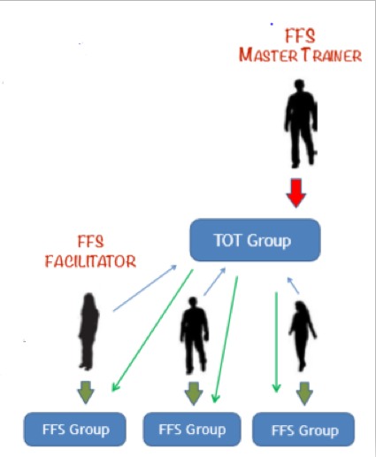
FFS STRUCTURE

Slide 11
FFS ACTIVITIES
FFS has a systematic training process where every FFS session comprises at least three major activities: agro-ecosystem analysis (AESA), a group dynamic activity and a topic of the day (Ruganzu et al,2015).
AESA involves regular field observation, problem analysis and presentation of feedbacks and discussion of action to take (Khisa & O’Brien, 2014).
This exercise last about two to three hours and is continually practiced throughout season or learning cycle in order to overlap with the real life farmer’s own field practices (Khisa & O’Brien, 2014).

Slide 12
Group dynamics is an important component of learning sessions which involves activities such as team building and social animation whereby participants share knowledge and culture (e.g. traditional dance, songs, poem etc), build cohesion, learn communication and leadership skills (Hagiwara et al, 2011).

Slide 13
Topic of the day is also part of FFS learning program which may be technical information to supplement the ‘learning by doing’ and field experimentation in FFS or it might be addressing wider crop issues (Khisa & O’Brien, 2014, Hagiwara et al, 2011).
and the topic maybe facilitated by an external person rather than a FFS group facilitator and the topic must be demand driven (Hagiwara et al, 2011).
The FFS session must be a half day period (4 to 5 hours long) (Khisa & O’Brien, 2014).

Slide 14
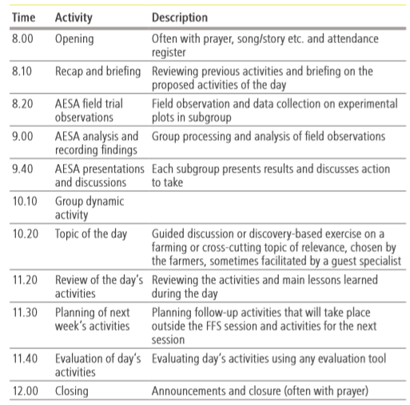
FFS SESSION SCHEDULE

Slide 15
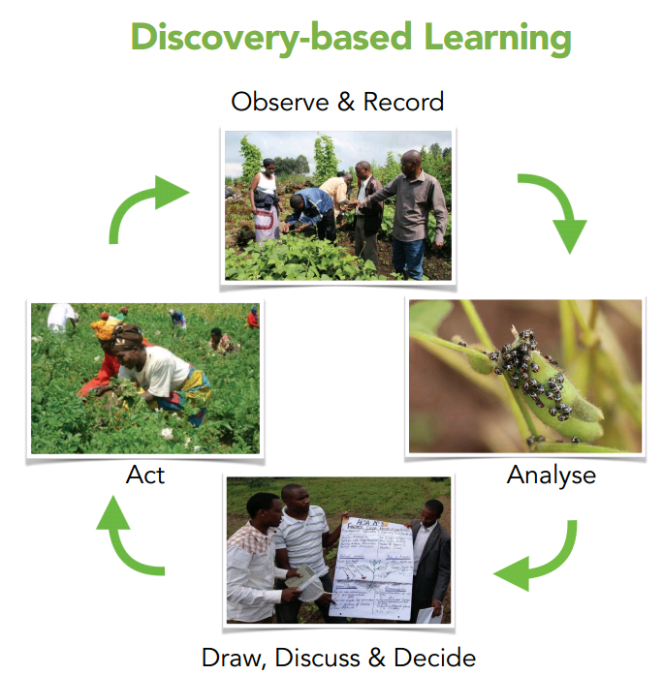

Slide 16
FFS ACHIEVEMENTS IN RWANDA
According to the data from Mid-Season assessment 2015B with 2924 FFS groups, 98% of FFS farmers reported that they were satisfied with the skills and attitude of FFS facilitator, 70% of FFS farmers put into practice in their own farm what they have learned, 76% of FFS farmers informed that productivity increased by at least 50% and 73% of FFS farmers informed that income has increased by at least 50% (CICA/MINAGRI, RAB & BTC,2017).

Slide 17
Apart from experimental studies in field plots, FFS farmers have other activities that help them to build a strong group such us savings where the member is able to borrow money with small interest of charge and also the group can decide later on what to do with that savings (CICA/MINAGRI, RAB & BTC,2017).
In addition, the group may decide to do an income generating activity such us growing crops for sale and the money earned are saved on group account (CICA/MINAGRI, RAB & BTC,2017).
According to CICA/MINAGRI, RAB & BTC (2015), 71% of the FFS groups had savings and 22% of FFS groups had external income generating activity.

Slide 18
ANALYSIS SUPPLEMENT WITH CASE ILLUSTRATION/ FIELD EXAMPLES
FFS implementation
FFS implementation undergo three stages: The Preparatory phase, the implementation phase and the post-graduation phase (Khisa & O’Brien, 2014).

Slide 19
Steps of Preparatory stage
1. Pre-condition survey
2. Identification and training of facilitators
3. General ground work
Establish contact with the community
Awareness-raising meeting to introduce the FFS concept
Identification and selection of the participants
Identification of the focal activity (FFS learning enterprise)
Identification of the learning site

Slide 20
4. Establishing the FFS
Participatory introduction of the participants
Levelling of expectations
Identifying the host team
Participatory planning of FFS activities:
(a) Establishing the FFS group
(b) Problem analysis and ranking
(c) Identifying potential solutions
(d) Developing the learning programme
(e) Developing a detailed budget
(f) Submitting a grant proposal
(g) Developing a participatory monitoring and evaluation (PM&E) plan

Slide 21
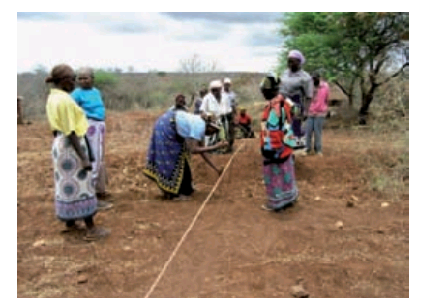
SITE PREPARATION

Slide 22
Steps of Implementation phase
5. Regular FFS sessions with core activities
Comparative experimentation
AESA
Topic of the day
Group dynamics
PM&E
6. Field days
7. Exchange visits
8. Graduation

Slide 23
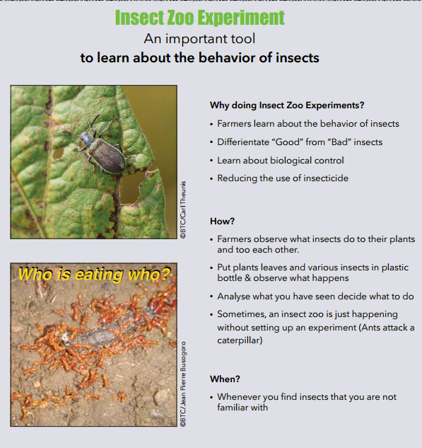

Slide 24
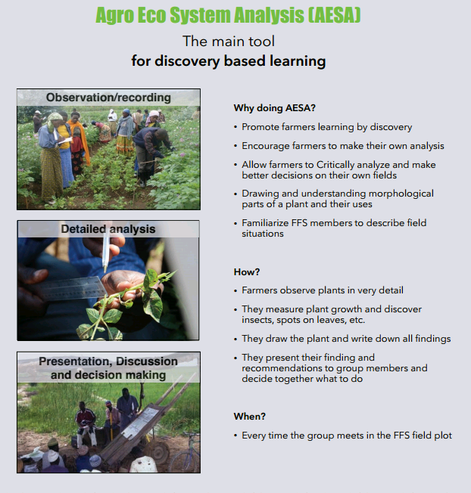

Slide 25


Slide 26
Steps of Post-graduation phase
9. Follow up of FFS activities
10. Establishing FFS networks
11. Income-generation activities
12. Setting up of second-generation FFS

Slide 27


Slide 28
Summary and Conclusion
To sum up FFS is an agricultural extension approach, where farmers learn by doing. In Rwanda, this approach started in 2009 by Belgian development agency (BTC-Rwanda) under IPM project. FFS also known as classroom without walls, is an approach aiming at strengthening farmers to make their own decision in their own fields. This approach improved the wellbeing of FFS farmers because many have generated income due to FFS Facilitators cooperatives. This approach is better but the challenge is that we still have many farmers who had no access to FFS approach.

Slide 29
Rwanda Youth Agribusiness Forum (RYAF) is a platform established in order to involve Rwandan youth in agriculture sector and I think this will help to boost implementation of FFS in many villages of the country because many youth have ability to know and adopt new idea than adult farmers who mostly are illiterate. FFS approach focuses on developing farmers more than developing new practices/technologies.

Slide 30
REFERENCE
Khisa, S.G., Okoth, J., O’Brien, E. (2014). Farmer Field School: Key Practices for DRR implementers. FAO, 2014. Retreived on October 29,2020 from https://www.fao.org/3/a-i37.66e.pdf
MINAGRI and BTC (2016). The plant is the teacher: farmer field schools in rwanda. Creative commons licence. Published in march 2016. Retrieved on October 29,2020 from https://www.enabel.be/sites/default/files/plants-is
Hagiwara, T., Ogawa, S., karinki, M.P., Ndeti, N.J., Kimondo, M.J. (2011). Farmer Field school: implementation guide. Kenya forest service, Food service, FAO and JICA. Published 2011. Retrieved on October 29, 2020.
Ruganzu et. Al. (2015). Farmer field schools facilitators Module: integrated soil fertility Management (ISFM). Rwanda soil health consortium, RAB, Kigali Rwanda.
Mesoamerican (n.d). Farmer field schools: concepts and Methodology. Mesoamerican agroenvironment program. Retrieved on October 29, 2020 from https:www.catie.ac.cv/cst/attachements/article/3/cartilla
Fao. 2019. Introduction to farmer field schools. A reader for instutitions of higher learning. Nairobi.44pp.licence.
CICA/MINAGRI, RAB AND BTC (2017). The plant is the teacher: the success of the farmer field school approach in rwanda. CICA/MINAGRI, RAB AND BTC. PUBLISHED JANUARY 2017.

