Slide 1
Introduction to Histology
February 2026
Tiruzer Bekele (MD, Anatomical pathologist and senior lecturer)

Slide 2
1. Introduction to histology
HISTOLOGY – The study of tissues (“histo” means tissue or web in Greek)
Histology is the science of microscopic anatomy of tissue and of how these tissues are arranged to constitute organs
This subject involves all aspects of tissue biology, with the focus on how cells’ structure and arrangement optimize functions specific to each organ
It provides a foundation for understanding the microscopic structure and functions of the organs
Many diseases profoundly alter the tissues within an affected organ

Slide 3
Tissues have two interacting components: cells and extracellular matrix (ECM).
The ECM consists of (fibers +ground substance + fluids)
The ECM supports the cells and contains the fluid transporting nutrients to the cells, and carrying away their wastes and secretory products.
Cells produce the ECM locally and are in turn strongly influenced by matrix molecules. (Bidirectional)
Many matrix components bind to specific cell surface receptors that span the cell membranes and connect to structural components inside the cells, forming a continuum in which cells and the ECM function together in a well coordinated manner

Slide 4
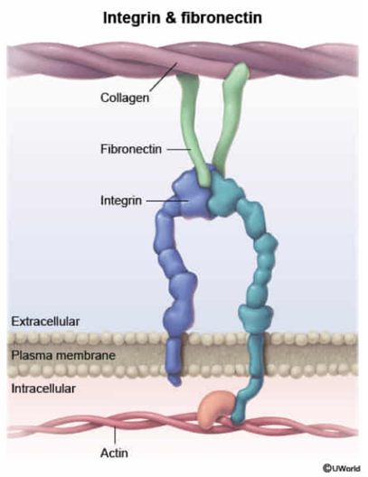

Slide 5
The small size of cells and matrix components makes histology dependent on the use of microscopes and molecular methods of study.
The most common procedure used in histologic research is the preparation of tissue slices or “sections” that can be examined visually with transmitted light (thin translucent sections are cut from tissues and placed on glass slides for microscopic examination of the internal structures)
The ideal microscopic preparation is preserved so that the tissue on the slide has the same structural features it had in the body. However, this is often not feasible because the preparation process can remove cellular lipid, with slight distortions of cell structure.

Slide 6
CYTOLOGY- The study of cells (Cytos/Kitos means cell in Greek)
Structural & functional units of life (and of disease processes) in all tissues, organs & organ systems
Independent units of life, which is viable and capable of multiplication
The human body contains>35 trillion cells each of which perform a specific function
In the 19th century, Rudolf Virchow, often referred to as the father of modern pathology, proposed that injury to the smallest living unit of the body, the cell, is the basis of all disease.
“Think microscopically”

Slide 7
Cells vary in size, shape, and function
Cells exhibit the following basic functional activities/properties:
  Metabolism (absorption, synthesis, respiration and excretion)
  Growth and regeneration,
  Irritability (excitability)
  Movement
  Reproduction
  Aging
  Death

Slide 8
Constituents of a cell:
  Water (60-70%)
  Electrolytes - inorganic compounds (5%),
  Proteins: enzymes, structural proteins and secretory proteins (15-20%),
  Lipids (15%) and
  Carbohydrates (1%).

Slide 9
Components of a cell
  Nucleus: Genetic material
  Cytoplasm: Limited by cell membrane
    Contains three structural components
      Organelles – metabolically active
      Cytoskeleton – structural framework (cell support + cell/organelle motility)
      Inclusions – cell products, metabolites (metabolically inactive)
      cytosol – fluid component of a cell

Slide 10
Cytoplasmic organelles: They can be classified into two types:
Membranous: Membrane bound
Endoplasmic reticulum, Golgi Apparatus, Mitochondria, Lysosomes
Peroxisomes, Endosomes
Non- membranous
Ribosomes, Centriole
Microtubuli, Microfilaments and intermediate filaments

Slide 11
Microtubules are important in maintaining cell shape and as tracks for transport of vesicles and organelles by the motor proteins kinesin and dynein
e.g. Defect in microtubules could result in male sterility and repeated infection from impaired leukocyte migration and phagocytosis
Intermediate filaments (e.g. cytokeratin, Vimentin, Desmin,Glial Fibrillary acid phosphatase)- Immunohistochemical stains e.g. used in tumor diagnosis

Slide 12
Inclusions (Nonliving accumulations of metabolites or cell products)
e.g. lipid droplets, glycogen granules and pigments like melanin, hemosiderin as well as lipofuscin
Cytoplasmic matrix ( cytosol)- viscous fluid medium with dissolved solutes like ions through which diffusion occurs + it supports organelles

Slide 13
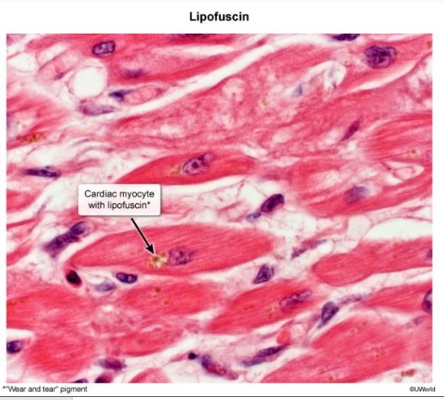

Slide 14
Plasma Membrane
Outer covering of all eukaryotic cells
Composed of a lipid bilayer and associated proteins
Functions
  As semi permeable membrane separating internal and external environment of a cell or an organelle
    Preventing intrusion of harmful substances, dispersion of macromolecules, dilution of enzymes & substrates
    Maintaining Homeostasis mechanism (maintaining optimal intracellular concentration of ions, H₂O, enzymes & substrates – through passive diffusion, facilitated diffusion and active transport)

Slide 15
A gatekeeper that regulate passage of substances into and out of the cell
As a sensory devise that permits the cell to recognize & be recognized by other cells & macromolecules.
Cell-to-cell attachment & communication

Slide 16
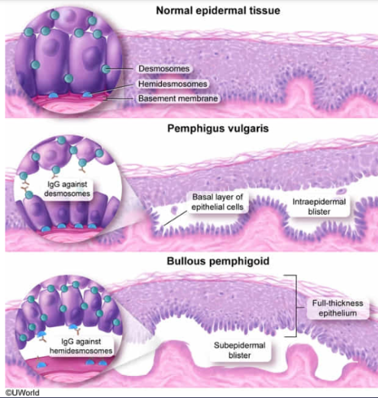
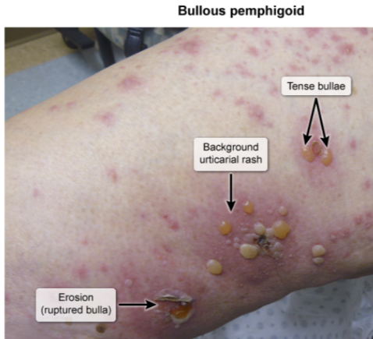

Slide 17
Endocytosis
  Phagocytosis (cell-eating): insoluble substances e.g. bacteria/dead cell by neutrophils/macrophages
  Pinocytosis(cell-drinking): fluid with solutes e.g. Thyroglobulin by thyroid follicular cells
  Receptor-mediated endocytosis: ligands & surface receptors e.g. LDL
Exocytosis e.g. exocrine pancreas and salivary glands
Signal transduction
  e.g. Nuclear receptors (steroids, retinoids, Vit. D, thyroid hormones)
Membrane modification helps to form cellular junction, cilia, and microvilli

Slide 18
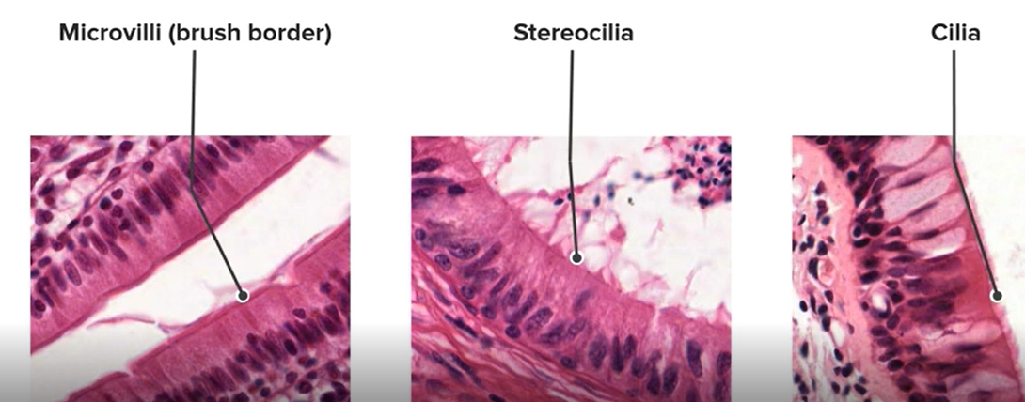

Slide 19
Signal Reception
  Communication of cells with one another to regulate their development into tissues, to control their growth and division, and to coordinate their functions
    Endocrine signaling:- hormones
    Paracrine signaling:- local cells only
    Synaptic signaling:- neurotransmitters via synapes
    Autocrine signaling:- self cell

