Slide 1
Mr. Tom NTAMBARA Distance learning coordinator UR-CST -M.Sc in Information system -B.Sc in compter Eng. & IT Contacts: tomntambara@gmail.com Tel: +250 788894624 /+250 728894624

Slide 2
E-learning Course Attended……….
USA (USTTI through SCOLA), Satellite and Internet Delivery of Educational Television and Multimedia
INDIA-CDAC (Specialized Programme on Design, Development & Implementation of E-Learning Courses)
Tulane University (USA) –Open Education-March 2013
ICT in teaching and learning Mathematics & Science Through EdQual Research program-Novembers 2007
AGH university of science and Technology in poland
Training program on Inclusive Publishing & Web Accessibility-26-29 May 2015, Kigali, Rwanda

Slide 3
PRESENTATION OUTLINE
Introduction
ICT in Rwanda
What is e-learning?
Status of e-learning at UR-CST
Importance of ODL
E-learning tool
Instructional design models
Moocs-Massive Open Online Courses
ICT WITH PWD
Benefits of studying through “ODL” mode
Challenges of studying through “ODL” mode
Emerging challenges
Conclusion

Slide 4
Introduction
Rwanda aims towards a knowledge based society and ICT stands as a key pillar
The 21st century needs people who can solve problems, make decisions, think critically, communicate ideas effectively and work efficiently within teams and groups.
Technologies are going to change school education especially in the way teachers teach and the way our students will learn (Surry and Land, 2000).

Slide 5
Introduction
The Government of Rwanda aims to transform Rwanda into a middle income country by 2020.
The application of eLearning in education has many benefits.
First and foremost electronically delivered content allows a student to learn at his or her own pace
until they have a complete understanding of the content.

Slide 6
ICT in Rwanda
In Rwanda the Information and Communication Technology (ICT) sector is singled out as a priority that can change dramatically society. ICT can contribute towards creating employment and generating incomes, including disadvantaged communities, notably among women, youth, and persons with disabilities.

Slide 7
Cont’
Since 1998, the Government of Rwanda has initiated an ICT development programme
An ICT-related policy was launched in 2000 in Rwanda
ICT as a development policy is expected to be realised through the implementation of four 5-year rolling National Information and Communication Infrastructure (NICI) Plans

Slide 8
Cont’
In 2000 GoR begun implementing the ICT4D policy, commonly known as NICI, and subsequently developed and implemented NICI I
(NICI-2005 Plan), the first of the four five-year rolling plans.
NICI I: Goal: To build the foundation and create an enabling environment for ICT development by putting in place the required institutional framework and policies in order to transform Rwanda into a knowledge-based society.
NICI II: Goal: To develop and deploy world class ICT infrastructure that will support and accelerate ICT development and growth.
NICI III: more flexible than previous ones in that it allows for easy adaptation to emerging technologies and sectoral changes. This approach ensures coherence and continuity throughout implementation of NICI III. Goal: To accelerate service development through ICT thereby facilitating sustainable economic
NICI IV: Goal: To consolidate the NICI process towards achieving a middle-income country status and an information-rich knowledge-based society and economy. The fourth plan will complete the NICI process by consolidating the country’s ICT transformation.

Slide 9
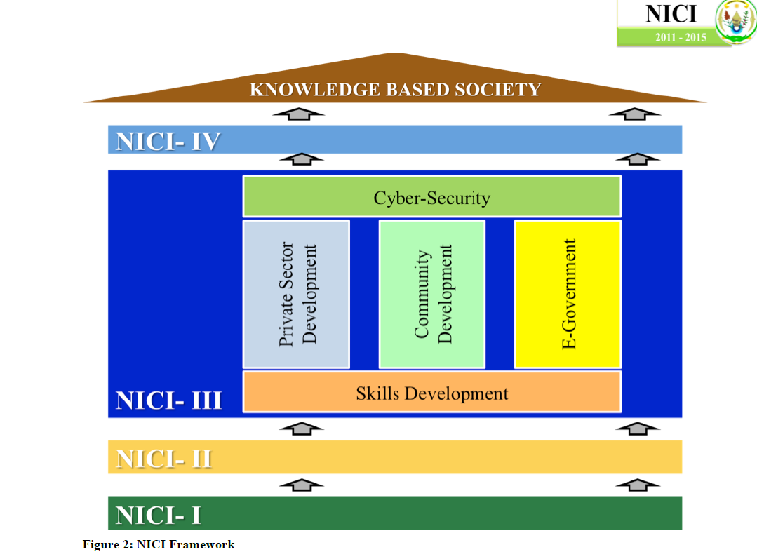
NICI plan
The NICI I Plan (2001-2005), the first of four to be developed within the framework of the Vision for
Rwanda (VfR), served as the cornerstone of the Government’s socio-economic development plan
over the period. The NICI I Plan was designed to provide details of how these policy commitments
of the Government could be translated into concrete programs and initiatives for implementation.s
The timeframes of the other NICI Plans were:
The NICI II Plan (2006 to 2010);
The NICI III Plan (2011 to 2015); and
The NICI IV Plan (2016 to 2020).

Slide 10
What others say………
ICT is also used as a tool for thinking in social practice (Bliss and Säljö, 1999)
The introduction of new tools in the course of social practice influences human development through interplay between people’s experiences, actions and motives (Vygotsky, 1978).
Computers, in their interplay with human activities, imply both quantitative and qualitative changes.

Slide 11
E-learning Definition
E-learning is a network technology-based mode of education that uses a mix of computer and other ICTs, across time and place constraints to deliver instruction and provide access to information resources ( Wallhaus, 2000).

Slide 12
Cont’
Online learning is defined as learning that takes place partially or entirely over the Internet.
It can involve delivery systems such as videotape, interactive audio-video, CD-ROMs, DVDs, video-conferencing, Video on Demand (VOD), e-mail, live chat, use of the Web, television and satellite broadcasts

Slide 13
Types of e-learning
There are fundamentally two types of e-Learning:
Synchronous training
Asynchronous training

Slide 14
Synchronous E-Learning (Virtual Classrooms):
Synchronous, means “at the same time,” involves interaction of participants with an instructor via the Web in real time.
Synchronous activities involve the exchange of ideas and information with one or more participants during the same period of time.
A face to face discussion is an example of synchronous communications.
Modernized methods such as instant writing and webcam chatting, and virtual classrooms where student is receiving updated feedback from his/her tutor are utilizing.

Slide 15
Asynchronous E-Learning:
Asynchronous, which means “not at the same time,” allows the participants to complete the WBT (Web-based training) at their own pace, without live interaction with the instructor
Asynchronous learning is a student-centered teaching method that uses online learning resources to facilitate information sharing outside the constraints of time and place among a network of people.
It’s a connection panel between teacher and learner where the later is receiving extensive lectures or study lessons thru some e-learning methods, like e-mail and video tapes, according to a planned study program where time and place is suitably choose.

Slide 16
Blended learning
"You may hear blended learning described as “integrative learning”, “hybrid learning”, “multi-method learning” (Node, 2001).
"The term "blended learning" is being used with increasing frequency in both academic and corporate circles.
A blended learning approach can combine face-to-face facilitation with computer-mediated instruction and/or discovery learning opportunities.
Mixing synchronous learning and asynchronous learning

Slide 17
Status of e-learning at UR-CST
E-Learning labs
One at KIST4 third floor with 52 computers, sound system and smart board.
KIST1 first floor (masters’ lab) with 20 computers, with pc and smart board.
Video conferencing room
Well equipped Server room
E-Learning policy
E-learning committee
Student e-learning club
Video conferencing system
Learning management system(Moodle)
Information KIOSK

Slide 18
Importance/Benefits of ODL
ODL allows students to take care of personal educational needs as well as of their families without facing the attendant risks associated with leaving them behind for an extended duration.
ODL mode requires very limited regulation of the studies by the host University

Slide 19
Cont’
ODL enables students to use knowledge and skills that they gain through the learning process immediately.
Through ODL, students do not have to leave their jobs, homes or self-employment while they study.

Slide 20
Technology-enhanced education offers a variety of opportunities for higher education institutions (HEI):
Widening the student body,
Engaging with non-traditional and remote learners,
Blending classroom and virtual higher education,
Cross-border cooperation between institutions,
Mainstreaming of a more interactive teaching and learning experience

Slide 21
Cont’
e-Learning offers learners 24/7 access to materials and support.
e-Learning enables more engaging materials to be created for a range of abilities and preferred learning styles.
e-Learning encourages the development of an independent learning culture.
e-Learning can offer learners access to materials and support any time, any place.
Online Efficiency
Class work can be scheduled around personal and professional work
Reduces travel cost and time to and from school
Learners may have the option to select learning materials that meets their level of knowledge and interest
Learners can study wherever they have access to a computer and Internet
Self-paced learning modules allow learners to work at their own pace
Flexibility to join discussions in the bulletin board threaded discussion areas at any hour, or visit with classmates and instructors remotely in chat rooms
Different learning styles are addressed and facilitation of learning occurs through varied activities
Development of computer and Internet skills that are transferable to other facets of learner's lives
Successfully completing online or computer-based courses builds self-knowledge and self-confidence and encourages students to take responsibility for their learning

Slide 22
ICT WITH PWD
Training program on Inclusive Publishing & Web Accessibility, 26-29 May 2015, Kigali, Rwanda
A census carried out in 2010 by (MINISANTE) and the (MINALOC) estimated the population of PWDs to be approximately 5% (522,856: 263,928 females and 258,928 males)

Slide 23
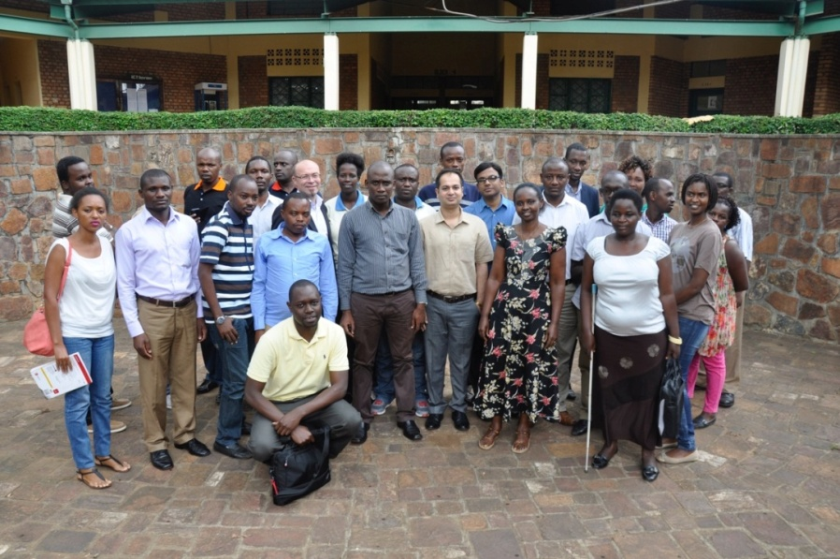


Technology makes LIFE EASIER FOR PEOPLE.
For persons with disabilities TECHNOLOGY MAKES LIFE POSSIBLE - The Assistive Technology Act of 1998 (US)
Accessibility Testing
http://idpf.org/]
www.daisy.org/education

Slide 24
Accessibility Testing – Manual
Screen Readers
NVDA – http://www.nvaccess.org/
JAWS for Windows – http://www.freedomscientific.com
Screen Magnifiers
ZoomText Xtra – http://www.aisquared.com
Dolphin Supernova – http://www.yourdolphin.com
Alternate Input devices –
Track ball and switch – http://www.ablenetinc.com
Dragon Naturally Speaking
http://www.nuance.com
Talkback– Built-in screen reader for Android devices
Voiceover – Built-in screen reader for iOS devices

Slide 25
E-learning tool
Moodle
Canvas
Blackboard
Vsee
TeacherTube
Youtube Recording
Screen-castomatic
Articulate studio 13
Turntin…Scipro

Slide 26
Moodle Definition
Moodle is a Course Management System (CMS), also known as a Learning Management System (LMS) or a Virtual Learning Environment (VLE).
It is a Free web application that educators can use to create effective online learning sites.
It has become very popular among educators around the world as a tool for creating online dynamic web sites for their students.
To work, it needs to be installed on a web server somewhere, either on one of your own computers or one at a web hosting company.

Slide 27
Moodle stands
Moodle (abbreviation for Modular Object-Oriented Dynamic Learning Environment) is a free source e-learning software platform, also known as a Course Management System, Learning Management System, or Virtual Learning Environment (VLE).

Slide 28
Who is Using Moodle?
Moodle is an ideal online learning solution for:
Colleges
Universities
Governmental Agencies
Businesses
Trade Associations
Hospitals
Libraries
Employment Agencies

Slide 29
Instructional design models
Merrill's First Principles of Instruction
ADDIE Model Dick and Carey Model
Kemp's Instructional Design Model
Gagné's Nine Events of Instruction
Bloom's Learning Taxonomy
Kirkpatrick's 4 Levels of Training Evaluation
Cathy Moore's Action Mapping

Slide 30
Moocs-Massive Open Online Courses
MOOC | Number of courses
MIT Free Courses | 2260 courses
Coursera | 1039 courses
edX | 535 courses
Canvas.net | 260 courses
FutureLearn | 157 courses
Miríada X | 137 courses
Independent | 121 courses
Udacity | 89 courses

Slide 31
EMERGING CHALLENGES
There are several potential constraints associated with intensified exploitation of ICTs that may or may be under the control of the Higher Education Institutions.
Inadequacy of ICT infrastructure and access;
Illiteracy of some lecturers and learners;
Lack of pedagogical skills and competence of some lecturers in using ICT;
Limited motivation of some instructors;
Mindset and perceptions of some lecturers and students;

Slide 32
EMERGING CHALLENGES Contd…
Power fluctuations and regular power cuts;
Low speed of internet as a result of narrow bandwidth.
Inability to buy laptops or other ICT accessories.

Slide 33
EMERGING CHALLENGES Contd…
Limited skills of integration of the different databases to ensure all databases can talk to each other. This calls for linkage with such friendly but non-commercial institutions as some from Asia or South America if such capacities do not exist in Africa.

Slide 34
Challenges………..
Unmotivated learners or those with poor study habits may fall behind
Students may feel isolated or miss social interaction
Instructor may not always be available on demand
Slow or unreliable Internet connections can be frustrating
Managing learning software can involve a learning curve
Some courses such as traditional hands-on courses can be difficult to simulate

Slide 35
E-learning organisation
McGraw-hill education based in Grece with McGraw-hill education digital learning products, conference on 2/06/2014 at UR-CST
KTM with its MOOCs and POOCs at MINEDUC on 19/04/2014
SCIPro with turntin software, antiplagiarism, for project assignment and supervision, confernce at UR head quarter on 18/1/2014
SmartEvals for course evaluation on 29/04/2014/
NextThought software from next hrough compan/y recievced email on 18/12/2014. I hope that Dr. Diane N. Karusisi knows more about it.
EPFL -Center for Digital Education. (Requested partnership to College of Science and Technology)
There was another 2 days workshop on 20th/1/2015 and 21/01/2015 In line with the “UR-Sweden Program for Research, Higher Learning and Institution Advancement”; the “Instructional Technology”.
HUAWEI e-course and e-classroom currently being used at College of Science and Technology.
And many others each one of us knows

Slide 36
The Changing Pedagogical Landscape-europe
The overall objective of the study is to examine to what extent government strategies and higher education regulatory and accreditation, funding, quality assurance, assessment and certification frameworks support or hinder new modes of learning and, in particular, the increased use of technology in the teaching and learning process.
Openness
Open text book by creative common licence from AGH University Sc & Tech.
Brussels Education Services sprl (Coordinator)
University of Edinburgh
European Association of Distance Teaching Universities (EADTU)
UPCnet
Brussels Education Services (BES) was founded in 2006 to provide education support services for EU cooperation

Slide 37
Recommendations
Training schools’ staff and faculty in the use of ICT in education,
upgrading schools existing technologies and try to buy new technologies
to create schools’ own softwares to manage libraries, registration & helping the community
more application of ICT in education 75% do not.

Slide 38
Recommendations
Use video conferencing, help students to have access to research and publication materials through the school’s website.
design ways on how to discourage plagiarism in teaching and learning
Provide teaching and learning materials online
Research and publication materials be accessed online by both students and teachers.

Slide 39
CONCLUSION
It has also demonstrated that the benefits of exploiting ICTs in the delivery of higher education are numerous.
Experience from OUT is a challenge to other higher learning institutions and ODL institutions in particular in Sub-Sahara Africa to also consider exploiting ICTs for enhanced learning of students.
However, the endeavour is challenging.

Slide 40
CONCLUSION
Learning to teach ICT and teaching with ICT
Development of school-based ICT skills backage for teachers and related pedagogy
Conclusion 6: it seems that both individual students’ and institutional inputs are needed as conditions to establish a sustainable ICT-based projects: motivated and committed students/teachers; institutional involvement in training and equipment

Slide 41
Concluding
The interplay of learning conditions based on reducing complexity of ICT-based learning and teaching materials for students’ proximity, using ICTs to cope with change, reflective practice, exposing students to authentic experiences and supporting active individual and institutional involvement can help to create a framework for the conceptualization of a formalized and sustainable ICT-based learning projects

Slide 42
THANKS

