Slide 1
Unit 12: Kinetic theory of gases
12.1 Basic principles of the kinetic theory of
gases
12.2 Fundamental equation of kinetic theory of
ideal gases
12.3 Maxwell’s law on the distribution of
molecules in an ideal gas according to the
velocities and energies of thermal motion
12.4 Barometric formula and Boltzmann’s
distribution

Slide 2
12.1 Basic principles of the kinetic theory of
gases
The kinetic theory of gases is the study of the composition and the physical properties of gases based on statistical methods of research. Thus, it is part of classical statistical physics.
Kinetic theory of gases is based on the principles of classical statistical physics. As a system of particles it assumes:
conservation laws of: energy, linear momentum, electric
charge, numbers of particles, etc.
all the particles are distinguishable.
all physical processes in the system occur in space and time
in a continuous way.
each particle of the system can have any coordinates and any
components of the velocity independently on the values of
these parameters for other particles.

Slide 3
Statistical method is based on the use of the theory of probabilities and models of a system constituted by a large number of particles. The average values (mean values) of physical quantities characterize the system.
12.2 Fundamental equation of kinetic theory of
ideal gases
An ideal gas can be considered as a system constituted by balls (molecules) in chaotic motion. The proper volume of molecules should be negligible and molecules do not interact at distance. Molecules are continuously in collision with other molecules of the gas and with the walls of the container exerting on them some pressure.
Thus, pressure is the macroscopic manifestation of thermal motion of the gas molecules.

Slide 4
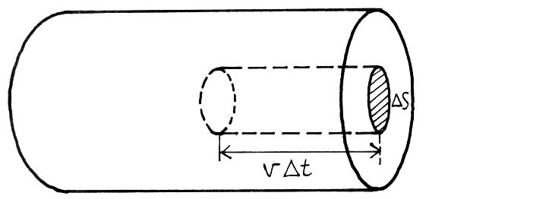
Maxwell has shown that in the case of an ideal gas, intermolecular collisions do not influence the pressure exerted by molecules on the walls of the container. Furthermore, Maxwell has shown that the gas pressure on the walls does not depend on the nature of the material the walls are made of.
Let us consider a monatomic ideal gas in a container
Let consider some elementary surface on the walls of the container and calculate the pressure exerted by the gas on the surface.
A molecule moving perpendicularly to the surface transfer to that surface a momentum:

Slide 5
Where and v are the mass and the velocity of the molecule.
During the time interval the surface will be attained by molecules
where n is the concentration of molecules.
In reality molecules are moving toward the base of the cylinder under different angles (and not only perpendicularly) and with different velocities and the velocity of each molecule can change (in magnitude and direction) at any collision. To simplify calculations, let us replace the chaotic motion of molecules by the motion along three perpendicular axes.
In that way molecules move along one axe and move in one direction and the other half move in opposite direction.
Therefore, the number of collisions of molecules moving in a given direction to the surface is:

Slide 6


when molecules enter in collision with the surface, they transfer to that surface a net momentum:
Thus, the gas exerts on the walls a pressure
or
If the volume of the gas is and the gas contain N molecules with speeds
, then we have to consider not the speed v but the
root-mean-square speed v_{q}
Often denoted as
Thus, we get:
fundamental equation of kinetic theory of gases for pressure.

Slide 7
As , we get:
or
On the other hand, we know that the total kinetic energy of the translational motion of all the molecules of a gas is given by:
we can write:
Let the total mass of the gas be m and
For one mole of a gas,
where
is the molar mass and
is the molar volume
we get:

Slide 8
From the equation of state of an ideal gas (Clapeyron-Mendeleev equation)
and therefore, we get:
Hence,
Since where is the mass of one molecule and is the Avogadro number, we get;
where is the Boltzmann’s constant.
The average kinetic energy of translational motion of a molecule of an ideal gas is:
or
Thus, the average kinetic energy of translational motion of a molecule of an ideal gas is proportional to the thermodynamic temperature.

Slide 9
From equation , it follows that when
Thus, when temperature T reaches the value 0K, the translational motion of ideal gas molecules ceases, and therefore the pressure equals zero.
Therefore, the thermodynamic temperature is the measure of the average kinetic energy of translational motion of ideal gas molecules and equation above gives the meaning of the temperature from the point of view of kinetic theory.

Slide 10
12.3 Maxwell’s law on the distribution of
molecules in an ideal gas according to the
velocities and energies of thermal motion
The root-mean-square speed of a molecule in a ideal gas in thermodynamic equilibrium state (at T=const) remains constant and is:
or
This can be explained by the fact that in a gas in a thermodynamic equilibrium state, some stationary distribution of molecules according to the speeds and governed by a well defined statistical law takes place. This law was theoretically established by Maxwell.
The law of Maxwell’s distribution is described by some function called function of the distribution of molecules according to speeds.

Slide 11
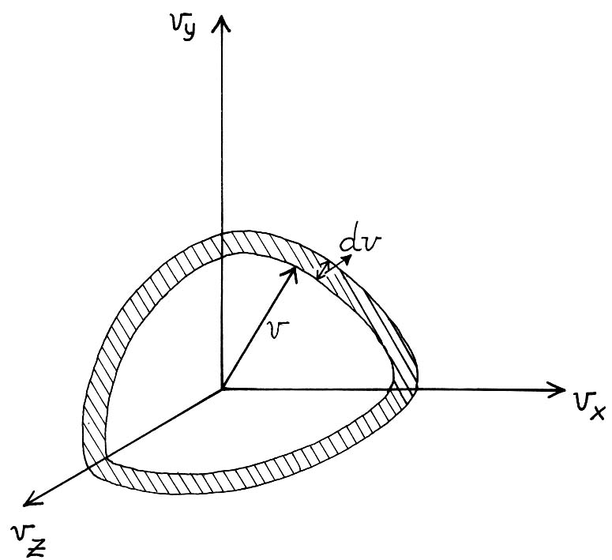
If we divide the interval of molecule speeds into small intervals , then to each small interval of speeds will correspond some number of molecules
having a speed belonging to that interval.
The function determines the relative number of molecules , whose speeds are in interval ,
i.e.
or
Using the models of theory of probabilities, Maxwell found that:

Slide 12
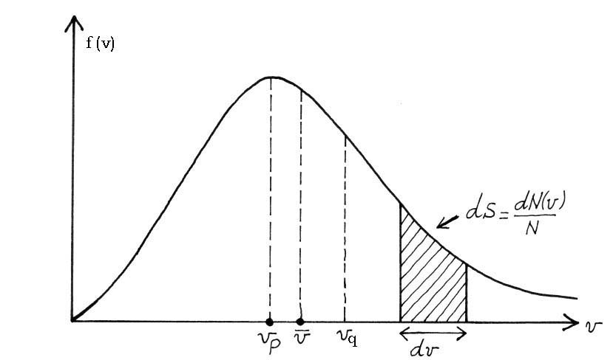
The distribution function f(v) depends on the mass of molecules and on a state parameter (the temperature T).
The function f(v) fulfils the normalization condition:
Maxwell’s distribution function f (v)

Slide 13
We call the most probable speed the speed corresponding to the maximum of the distribution function of molecules.
This speed is obtained by solving the equation:
which gives:
The values v = 0 and in equation correspond to the minimum values of the distribution function f(v), whereas
is the most probable speed (i.e. the speed corresponding to the maximum value of ).

Slide 14
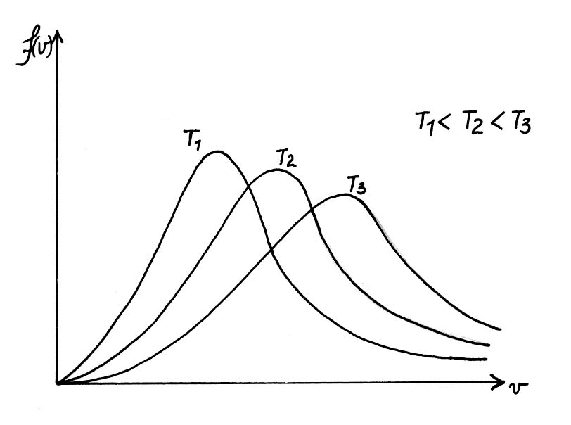
When temperature increases, the maximum function of molecule distribution according to speeds is displaced on the right (which means that the most probable speed also increases) but the surface enclosed by the curve and the speed axis remains constant (equal to 1).
This means that the maximum value of f (v) becomes more and more small when temperature increases (see figure below)
f (v) for different temperatures

Slide 15
The arithmetic average speed is defined as follows:
After integration, we get:
As we have seen above,
the root-mean-square speed is defined as:
and the most probable speed:
It is clear that:

Slide 16
The distribution of molecules according to speeds can be written as:
We also write the distribution of molecules according to kinetic energy
Let us make a change of variables from v to
we have:
and
Then,
where is the number of molecules having kinetic energy in
Interval .

Slide 17
Therefore, the distribution function of molecules according to energy of thermal motion is:
The average kinetic energy of one molecule of a monatomic ideal gas is:
Thus,
As it was expected, we have found the same result as the result obtained above as the average energy of translational motion of the molecule.

Slide 18
Since the kinetic energy of a molecule is equal to three times
and the molecule has three equivalent degrees of freedom, we can conclude that to each degree of freedom corresponds an average energy equal to .
This result established for a monatomic ideal gas holds also for a polyatomic ideal gas and constitutes the law of equipartion of kinetic energy according to degrees of freedom.
Thus, the average kinetic energy of a molecule having i degrees of freedom is equal to:
the number of degrees of freedom is equal to the minimum number of independent parameters to be given in order to determine completely the state of the system.
Thus the internal energy of one mole of an ideal gas is constituted by the kinetic energy of its molecules and is given by:
Thus, the internal energy of an ideal gas depends linearly on thermodynamic temperature of that gas (T) and on the number of the degrees of freedom of its molecules (i).

Slide 19
Remark:
This conclusion does not hold for a real gas. In real gases, the internal energy comprises also the potential energy of interactions between molecules which depends on average distance between molecules, i.e. on the specific volume of the gas, and on the types of intermolecular forces. For this reason, the internal energy of a real gas cannot be found only on the basis of the law of equipartition of energy by degrees of freedom.

Slide 20
12.4 Barometric formula and Boltzmann’s
distribution
The fundamental equation of kinetic theory of gases was obtained by assuming that external forces do not act on molecules of a gas and therefore, these molecules are uniformly distributed in all the volume of the gas.
However, molecules of any gas are in the field of gravity. The force of gravity from one side and the thermal motion of gas molecules from the other side lead to some stationary state of the gas in which the pressure of the gas decreases with the height.
If there were no thermal motion, all the molecules of the atmospheric air should fall on the earth because of the gravity; and if the force of the gravity were absent, all the atmospheric air will scatter in the all universe.

