Slide 2

Unit 1: States of matter

Slide 3

Activity 1.1 (Duration: 2 Minutes)
Think-pair-share on the following questions
Discuss the type of matter we have and their properties?
Can you give evidence of your explanations?

Slide 4

Indicative content of this unit 1
1.0. Introduction
1.1. Molecular forces
1.2. Molecular interaction
1.3. Potential energy of molecular interaction
1.4. Mole
1.5. Elastic and Plastic properties of matter
1.6. Relations between different moduli of elasticity

Slide 5

INTRODUCTION INTRODUCTION
1.1. State of matter
The states of matter can be explained based on atomic hypothesis.
One of the greatest physicist of the century Feynman, 1977 said “all matter are made of atoms and molecules.
Between molecules there are forces called molecular forces.
Inter molecular forces can be explained fully by the quantum physics but here we use only the classical physics to show their qualitative picture.

Slide 6
INTRODUCTION INTRODUCTION
1.1. State of matter (cont)
Matter is found in 3 states: solid, liquid and gas.
Solids have a definite volume and shape.
Liquids have a definite volume but no definite shape
Gas have neither a definite volume nor definite shape.
Liquids and gas are also called fluids.
Fluids do not maintain their shape but they flow.

Slide 7
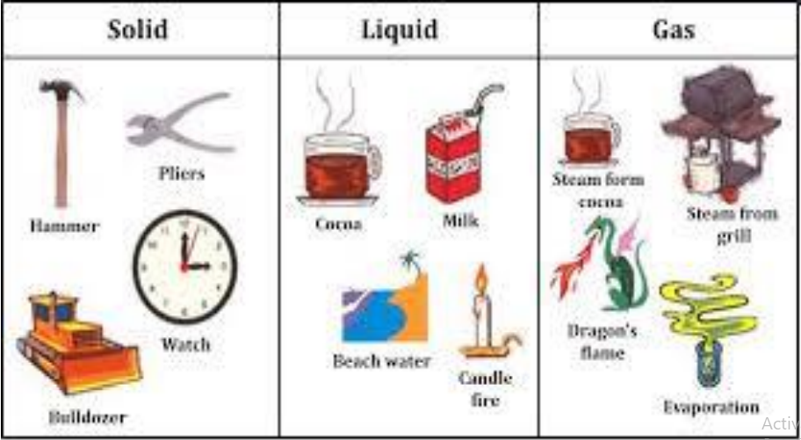
INTRODUCTION INTRODUCTION
1.1. States of matter (cont’)

Slide 8
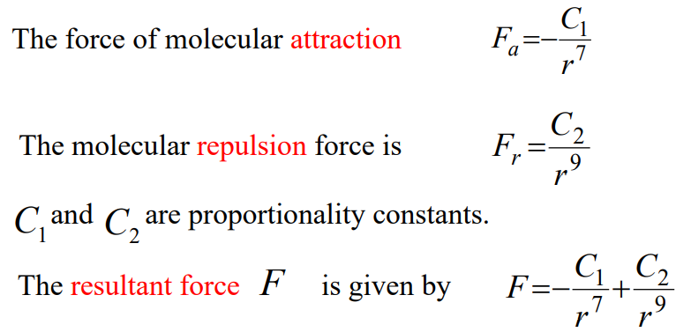
INTRODUCTION INTRODUCTION
1.2. Molecular interaction
Molecular force is of two kinds: molecular attraction and molecular repulsion.
When molecules are sufficiently far apart, more than the linear dimensions of the molecules, they feel attraction force. Otherwise they feel repulsion force.

Slide 9
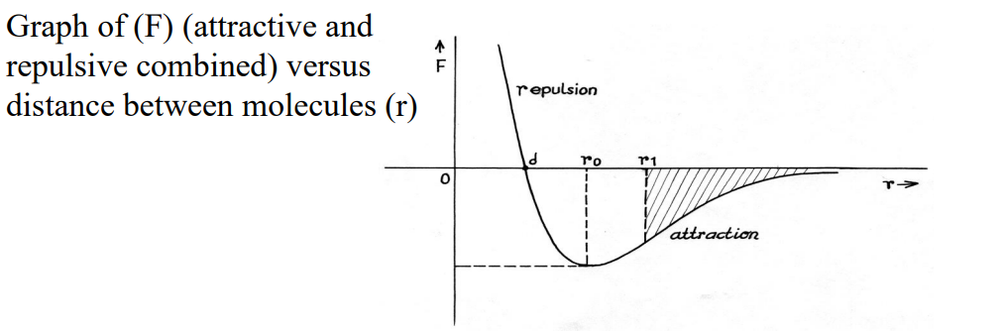
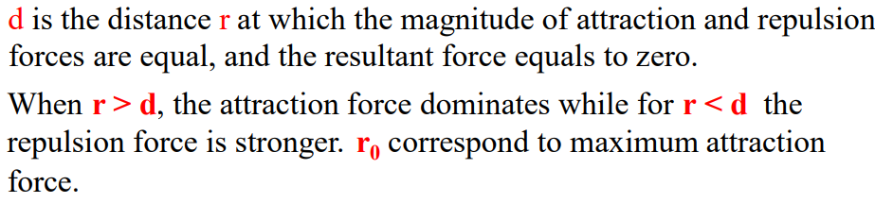
INTRODUCTION INTRODUCTION
1.2. Molecular interaction(cont’)

Slide 10
INTRODUCTION INTRODUCTION
1.2. Molecular interaction(cont’)
When the distances are several times d, the net force becomes practically zero
There is a strong dependence of the molecular force on the distance r.
This shows that molecular forces are short-ranged (molecules interact with their closest neighbours).
In solids, all atoms are held together due to the balance of attraction and repulsion (when they are at distance d)
If the molecules are pushed only a very small distance closer or pushed only a very small distance farther than d, the force is proportional to the displacement (Hooke’s law to be seen later).

Slide 11
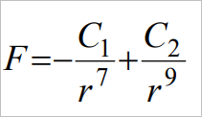
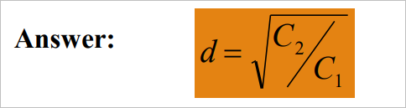

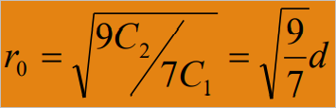

Activity 1.2 (Duration: 3 Minutes)
1. Calculate the distance r = d in terms of C1 and C2 (when F = 0). we know that:
2) Find the distance r=ro corresponding to the max force of attraction. Answer

Slide 12
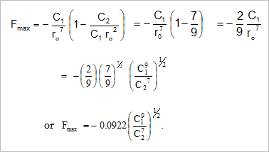
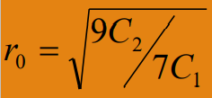
Activity 1.2 (Duration: 3 Minutes)
3. Find the maximum attraction force in terms of constants C1 and C2. Answer

Slide 13
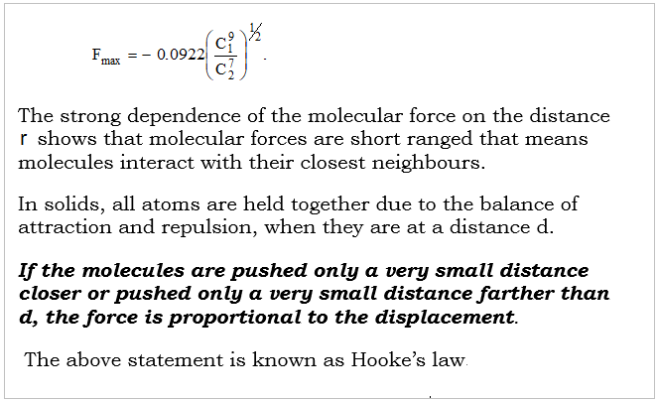
Activity 1.2 (Duration: 3 Minutes)

Slide 14
INTRODUCTION INTRODUCTION
1.2. Molecular interaction(cont’)
When the distances are several times d, the net force becomes practically zero
There is a strong dependence of the molecular force on the distance r.
This shows that molecular forces are short-ranged (molecules interact with their closest neighbours).
In solids, all atoms are held together due to the balance of attraction and repulsion (when they are at distance d)
If the molecules are pushed only a very small distance closer or pushed only a very small distance farther than d, the force is proportional to the displacement (Hooke’s law to be seen later).

Slide 15
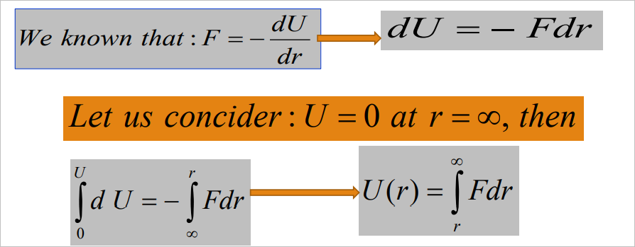
INTRODUCTION INTRODUCTION
1.3. Potential energy curve of molecular interaction
We want to represent the relationship between the potential energy U and intermolecular distance r.
U(r) which is very important in order to understand the interaction between molecules.

Slide 16
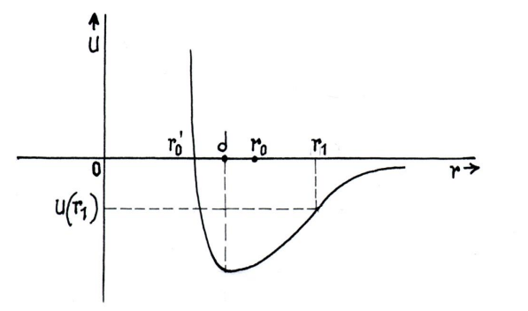
INTRODUCTION INTRODUCTION
1.3. Potential energy curve of molecular interaction
When r < d, F is positive (repulsive force). The slope should be negative and makes an obtuse angle with r axis. When r > d, F is negative (attraction force). Then the slope makes an acute angle with the r –axis. The curve has a minimum at r = d (where F=0).

Slide 17
INTRODUCTION INTRODUCTION
1.3. Potential energy curve of molecular interaction
The repulsion force varies more strongly with the distance than attraction force. Thus the potential energy curve is asymmetrical.
When r < d, the curve is more steep and when r > d it is less steep and flattens out when r becomes bigger until the force of interaction is zero, the potential energy becomes also zero.
This property of U(r) curve can explain some properties of solids, liquids and gases. When the material is in a solid state at low T, the molecules oscillate close to the mean position.
When the T increases, as the curve is nonsymmetrical, the mean position is displaced to the left and the intermolecular distance increases. This explains the thermal expansion.

Slide 18
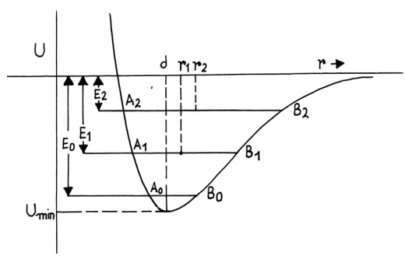
INTRODUCTION INTRODUCTION
1.3. Potential energy curve of molecular interaction
If the Temperature is high, the molecules become more free, and solid converts into liquid. But the attraction between molecules hold them together and the liquid keeps its volume.
If the T is increased further, vibrations increase and the distance between molecules increase. If the T continues to increase, the attraction between molecules is not enough to hold them together. In this case, the bond is broken, and the liquid is converted into gas.

Slide 19

INTRODUCTION INTRODUCTION
1.4. Mole
Macroscopically we can estimate the size of a molecule, using the definition of mole. The mole is a fundamental unit in the international system, and it is equal to the amount of a substance that contains the same number of particles as there are atoms in 12 grams of carbon-12.
The particles can be: atoms, molecules, ions, electrons, or other specific particles. The number of atoms in 12 grams of carbon-12 is
and is known as the Avogadro constant NA

Slide 20
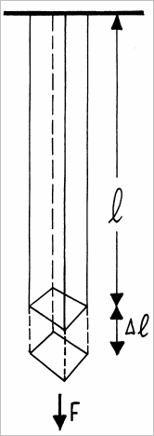
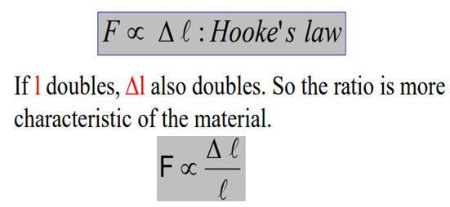
INTRODUCTION INTRODUCTION
1.5. Elastic and Plastic properties of matter
a) Fundamental law of Elasticity
How much and in what way a solid will deform under the action of an applied force?
Suppose we take a bar of length l from which a weight can be hung.
For a given weight (F), the bar extends a length Δl. For small extension, the applied force is proportional to the extension.
Theophile MUSENGIMANA

Slide 21

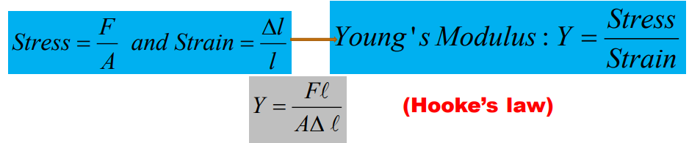
INTRODUCTION INTRODUCTION
Fundamental law of Elasticity
The force is also proportional to the cross-sectional area of the material we get the Hooke’s law:
Where is the constant of proportionality and is called Young’s modulus and is the property of the material. Hooke’s law can also be written in form of stress and strain. Stress can be defined as the strength of force causing the deformation and strain as the resulting deformation.

Slide 22
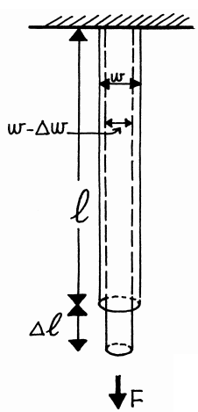
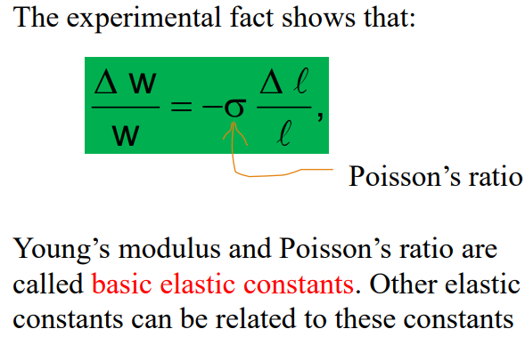
Poisson’s ratio
Another property of the material is Poisson’s ratio. If a solid is elongated in length, the material, which makes up the extra length comes from the contraction in width

Slide 23
INTRODUCTION INTRODUCTION
Principle of superposition for elasticity
When several stresses apply simultaneously on a body, each stress produces its own strain just as if no other stress were present.

Slide 24
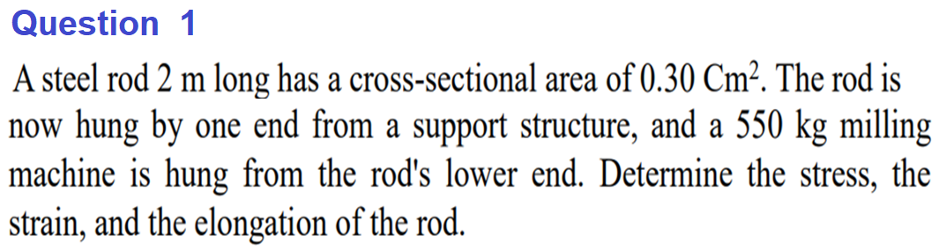
Activity1 (Duration: 10 Minutes)

Slide 25
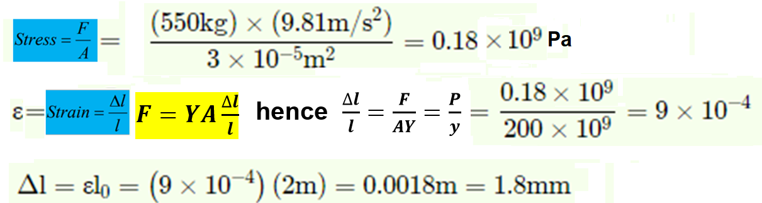
Q1. Answer

Slide 26
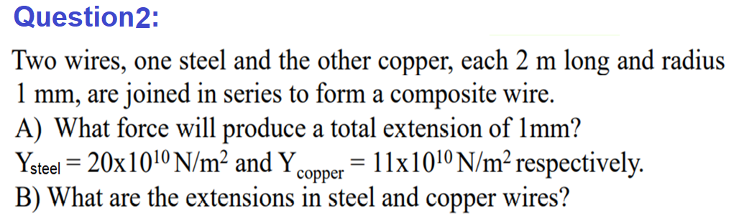
Activity2 (Duration: 10 Minutes)

Slide 27
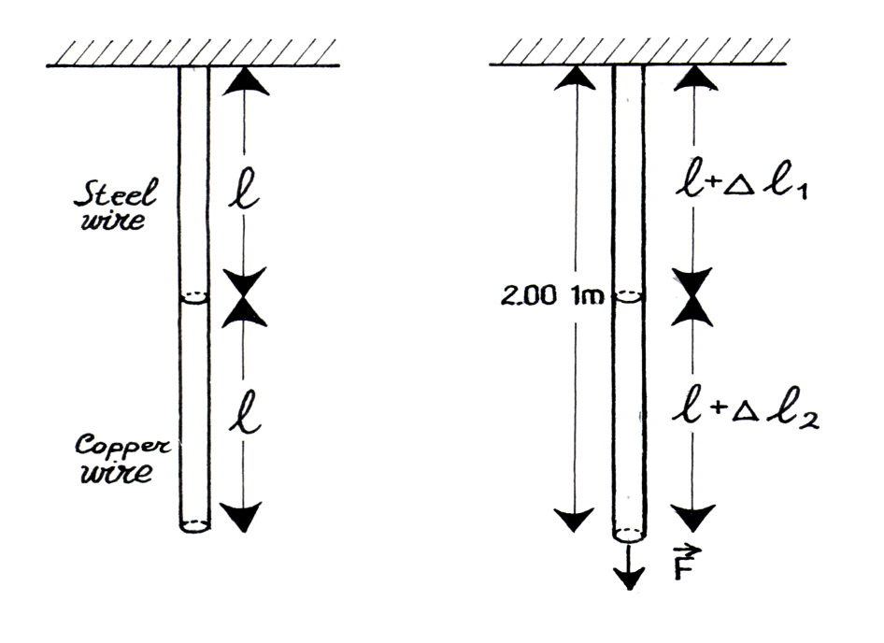
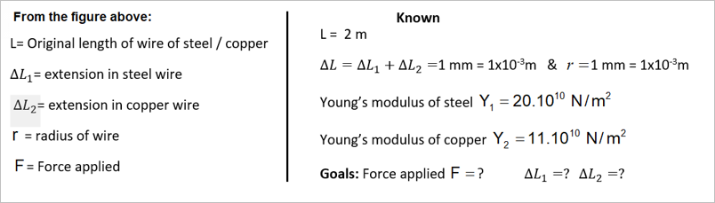
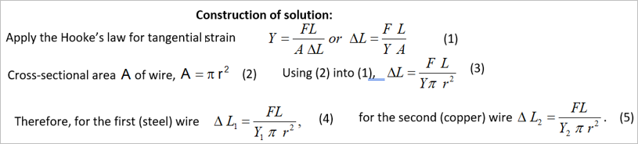
Q2. Answer
l=Original length of wire of steel / copper

Slide 28
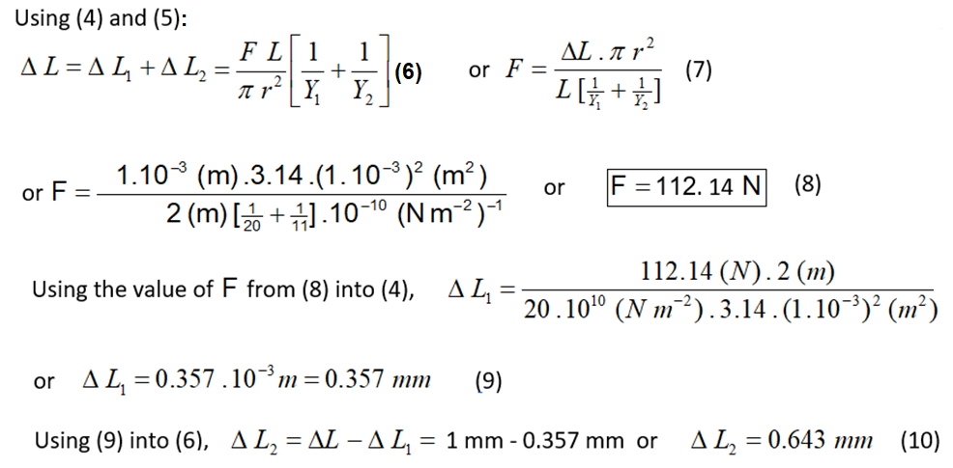
Answer (cont’)

Slide 29
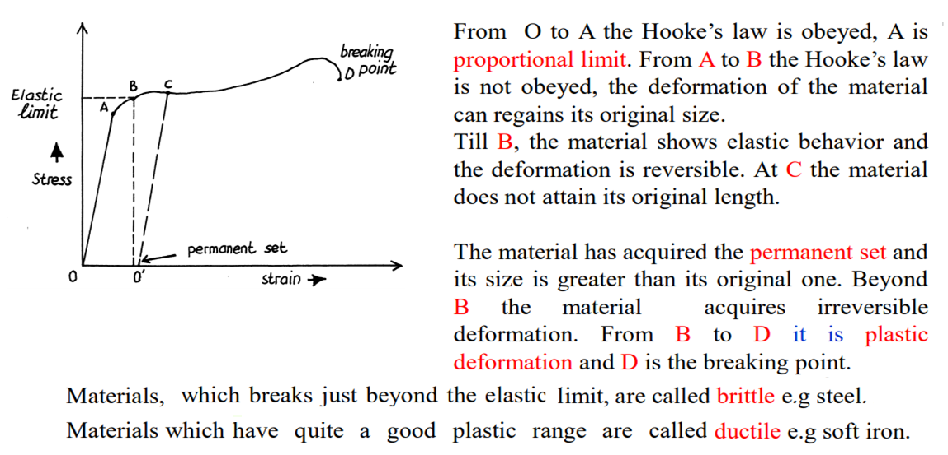
INTRODUCTION INTRODUCTION
b) Stress-strain diagram

Slide 30
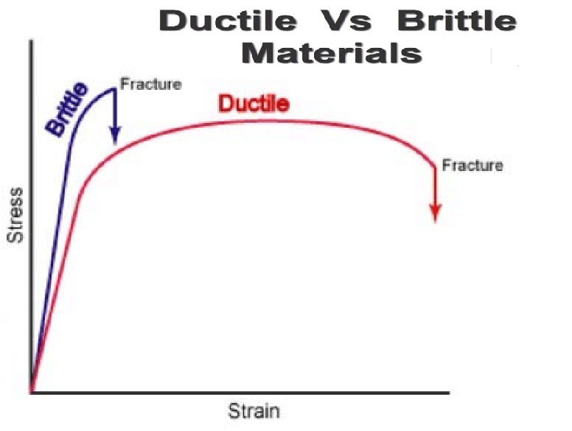
INTRODUCTION INTRODUCTION

Slide 31
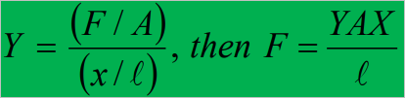
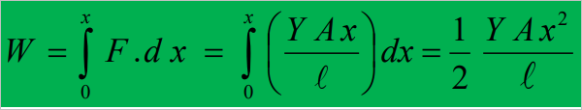
INTRODUCTION INTRODUCTION
Elastic potential energy
When a force is applied on a body and that body is deformed, a work has been done on the body.
This work is stored in the body in the form of potential energy or elastic potential energy. Let calculate this work: We know that:
The work done W during the extension in the length of the wire from 0 to x is given by:

Slide 32
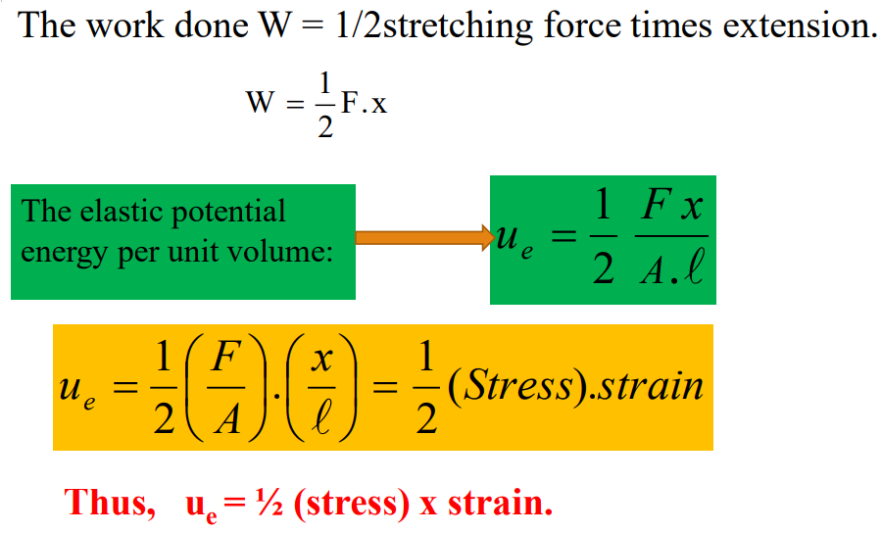
INTRODUCTION INTRODUCTION
Elastic potential energy(cont)

Slide 33
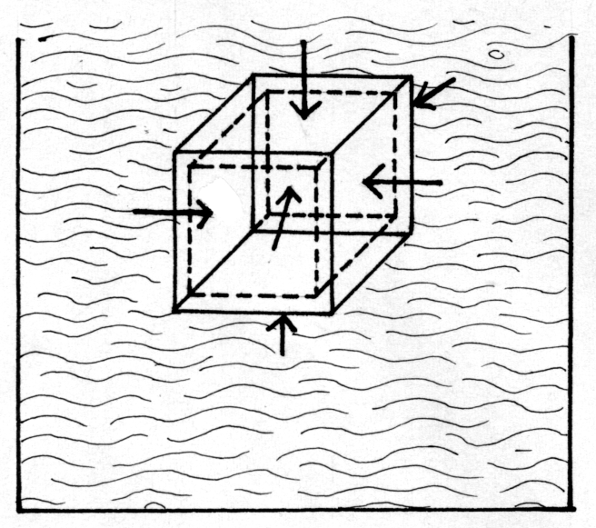
1.6. Relations between moduli of elasticity
a) Bulk modulus
When a block is put into deep water, the water exerts a uniform pressure everywhere on the surface of the block and the volume of the block decreases a bit.
The stress is volume stress or bulk stress exerted perpendicularly on all sides of the block and is equal to pressure
The strain is volume strain or bulk strain
For a given material, the ratio of bulk stress and bulk strain is constant and is called bulk module (B).

Slide 34
Bulk modulus
When the pressure on a body changes by a small amount from to and the resulting bulk strain is Hooke’s law takes the form:
The minus sign shows that when the pressure is increased, the volume of the object is decreased and the vice versa.
The reciprocal of the bulk modulus is known as compressibility.
Compressibility: =
The bulk modulus of gas is also defined in the same way as compressibility .

Slide 35
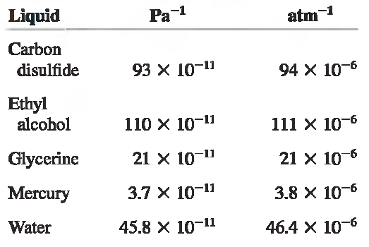
Bulk modulus
Examples of compressibility of liquids k.

Slide 36
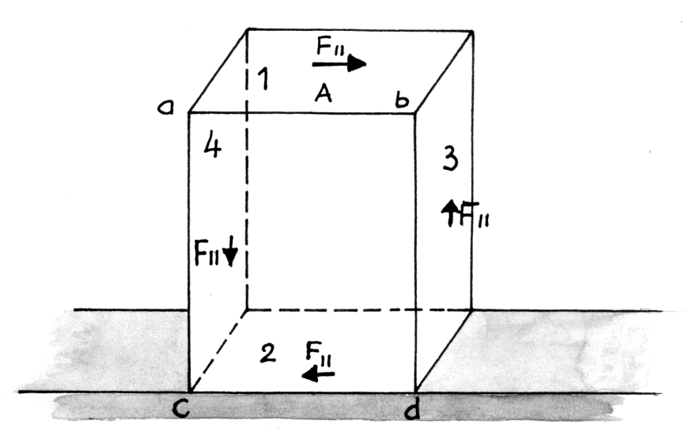
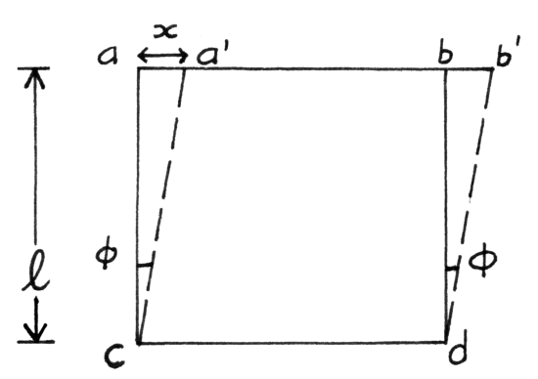
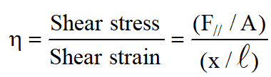
b) Shear modulus or modulus of rigidity
Let consider a cube for which a share stress is applied tangent to face 1 and 2. We define the share stress as the ratio of the force applied to the surface area of face 1:
and share strain, as the ratio of the displacement of corner to the transverse dimension
Share modulus is then:

Slide 37
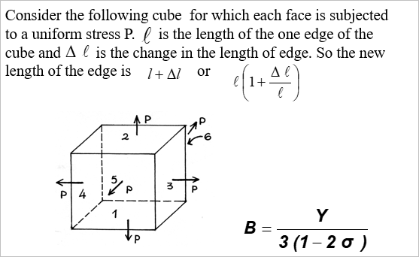
c) Relation between B, Y and σ
.

Slide 38
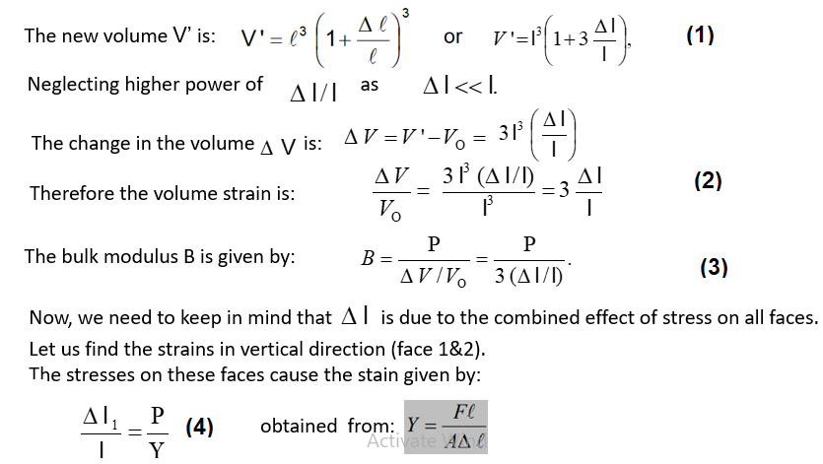
c) Relation between B, Y and σ
.

Slide 39

c) Relation between B, Y and σ
The stresses on face 3 & 4 cause a strain of or
.
The stresses on face 5 & 6 cause a strain of
Using the principle of superposition for elasticity
The total strain in the vertical direction
and is given by
or
or
As the bulk modulus is positive for any material, from eq of B, it is clear that
or should be less than 0.5

Slide 40
Relation between shear modulus η, Young’s Modulus Y and Poisson’s ratio σ
(See derivation in notes of module PHY 102 p. 54)
Relation between Y, B and η ; B, η and σ
(See derivation in notes of module PHY 102 p. 54)

Slide 41
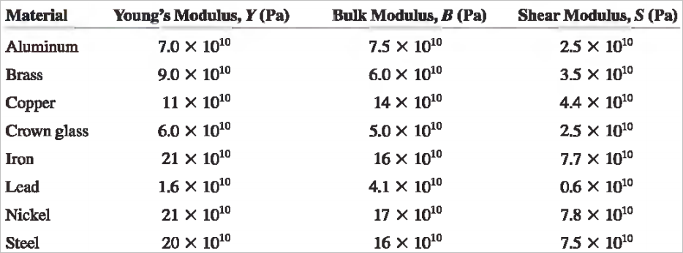
INTRODUCTION INTRODUCTION
Example of some elastic constant of materials

